Slide 1
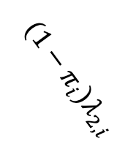






Incarceration dynamics
HCV transmission dynamics for PWID
$$β_{i}(t)$$
$$λ_{3,i}$$
Susceptible (U)
Never Incarcerated PWID (D)
$$λ_{1,i}$$
Currently Incarcerated Ex-PWID (J)
$$π_{i}λ_{2,i}$$
Formerly Incarcerated PWID (F)
Acute infection (A)
Treatment (T)
$${(1−π}_{i}{)λ}_{2,i}$$
Ex-PWID (X)
Chronic infection (C)
Liver disease progression
Non-Cirrhosis (NC)
Compensated Cirrhosis (CC)
Decompensated Cirrhosis (DC)
Hepatocellular Carcinoma (HCC)
$$μ_{DC}$$
$$μ_{HCC}$$

Slide 2
Liver disease progression
Non-Cirrhosis (NC)
Compensated Cirrhosis (CC)
Decompensated Cirrhosis (DC)
Hepatocellular Carcinoma (HCC)

Slide 3





HCV transmission dynamics for PWID
$$κ/ι_{1}$$
Susceptible (U)
$$γ_{i,j}(t)$$
Acute infection (A)
$$(1−κ)/ι_{1}$$
Chronic infection (C)
$$τ_{k}$$
Treatment (T)
$$1/ι_{2}$$

Slide 4
Liver disease progression
Slower progression rate if SVR
Non-Cirrhosis (NC)
Compensated Cirrhosis (CC)
Decompensated Cirrhosis
(DC)
Hepatocellular Carcinoma
(HCC)
Susceptible (u)
Susceptible (u)
Susceptible (u)
Susceptible (u)
Acute infection (a)
Treatment (t)
Acute infection (a)
Treatment (t)
Acute infection (a)
Treatment (t)
Acute infection (a)
Treatment (t)
Chronic infection (c)
Chronic infection (c)
Chronic infection (c)
Chronic infection (c)

Slide 5
1. Drug abusers inflow age group distribution + absolute figure -> don’t know
2. Lack HCC-specific SVR rates incurred by SOF/VEL
3. Don’t know proportion of taking RBV in DC
4. Should we split HCC into several stages (active + inactive)? And also add liver transplantation?
5. Genotype distribution
6. Opioid Substitution Therapy (OST) and Needle and Syringe Programmes (NSPs) -> only in some correctional facilities now

Slide 6
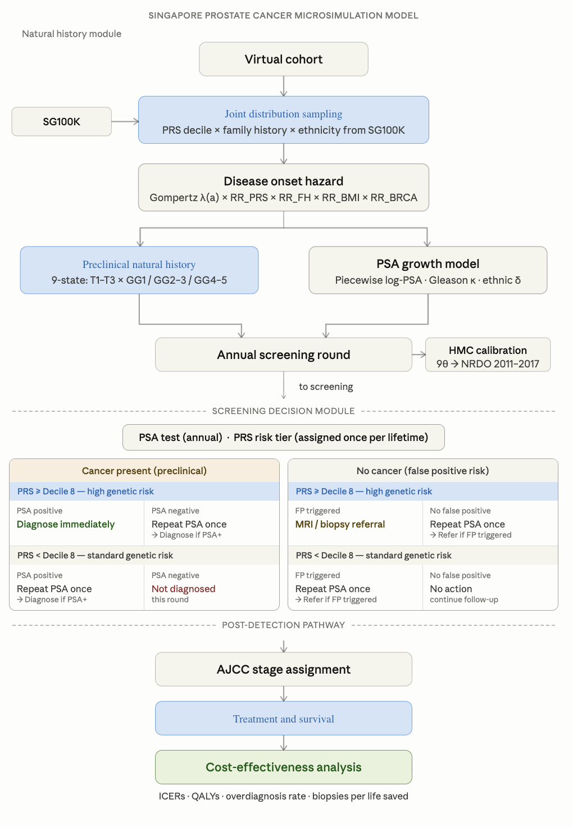

Slide 7
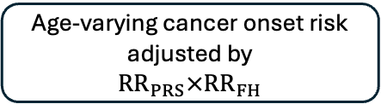
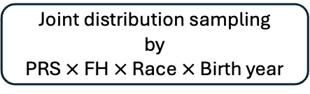
a. DEMOS-MISCAN-Pro
Preclinical
T1, G<7
T1, G<7
T1, G=7
T1, G=7
DEMOS
(Virtual healthy cohort)
T1, G>7
T1, G>7
T2, G<7
T2, G<7
Joint distribution sampling
by
PRS $×$ FH $×$ Race $×$ Birth year
Clinical Diagnosis
T2, G=7
T2, G=7
Death
Age-varying cancer onset risk
adjusted by
${RR}_{PRS}×{RR}_{FH}$
T2, G>7
T2, G>7
T3, G<7
T3, G<7
T3, G=7
T3, G=7
T3, G>7
T3, G>7
b. Screening
Diagnosed
y
PRS
Top 20%?
Diagnosed
y
Treatment
n
Repeat PSA once
y
n
Not Diagnosed
y
Eligible individual
PSA
positive?
MRI/biopsy
Prostate Cancer Confirmed
Diagnosed
n
y
n
Repeat PSA once
y
PRS
Top 20%?
n
Not Diagnosed
Back to normal
n
Not Diagnosed

Slide 8
Screening
Diagnosed
y
PRS
> decile 8?
Diagnosed
y
Treatment
n
Repeat PSA once
y
n
Not Diagnosed
y
Eligible individual
PSA
positive?
MRI/biopsy
False
Positive?
Diagnosed
n
y
n
Repeat PSA once
y
PRS
> decile 8?
n
Not Diagnosed
Back to normal
n
Not Diagnosed

Slide 9
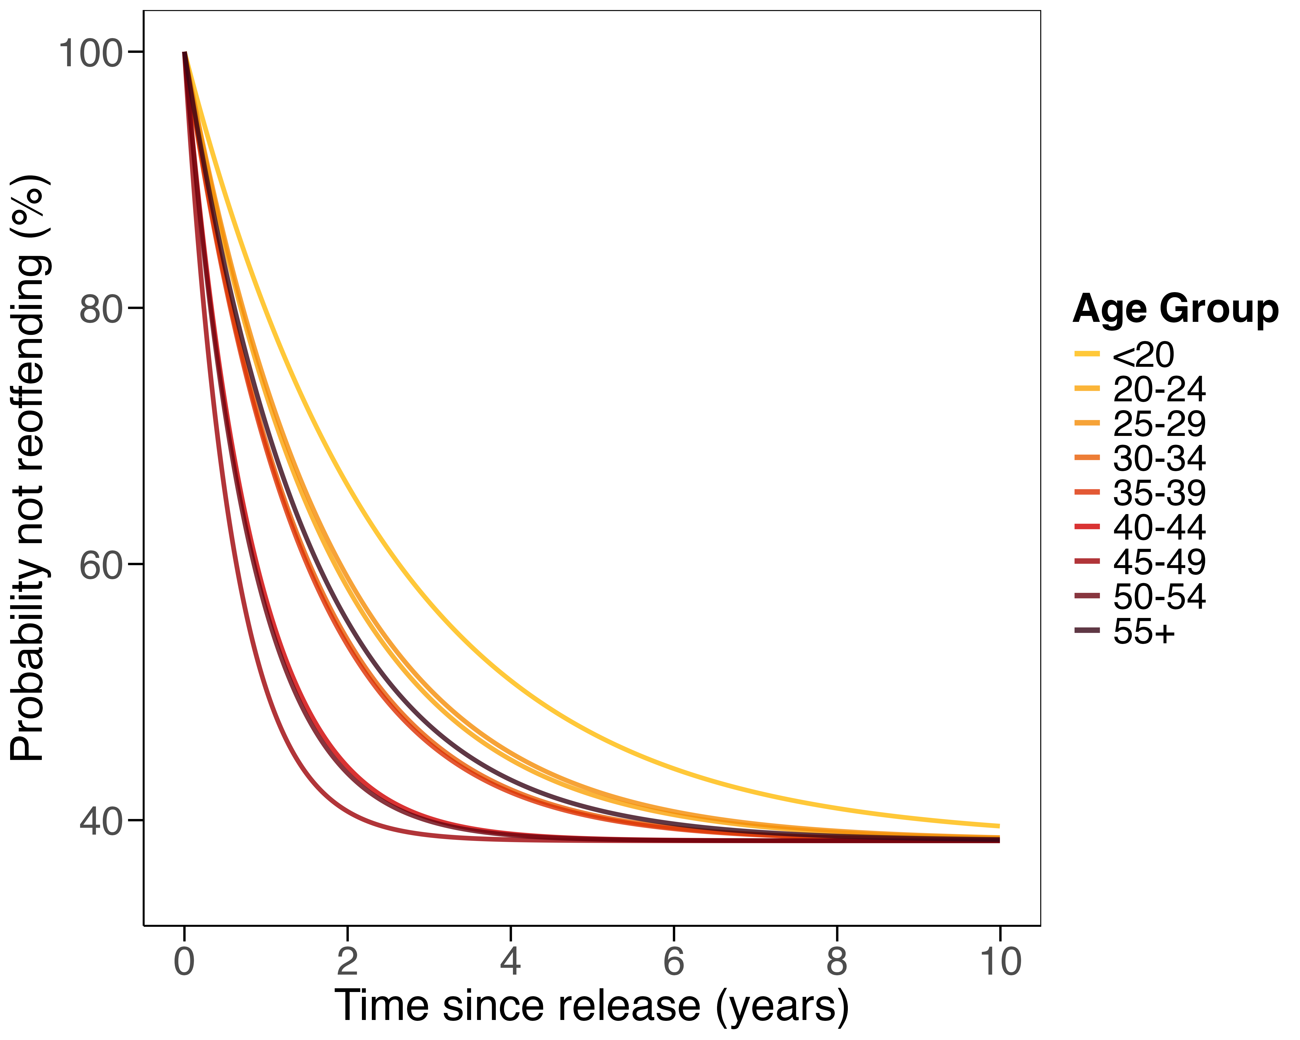
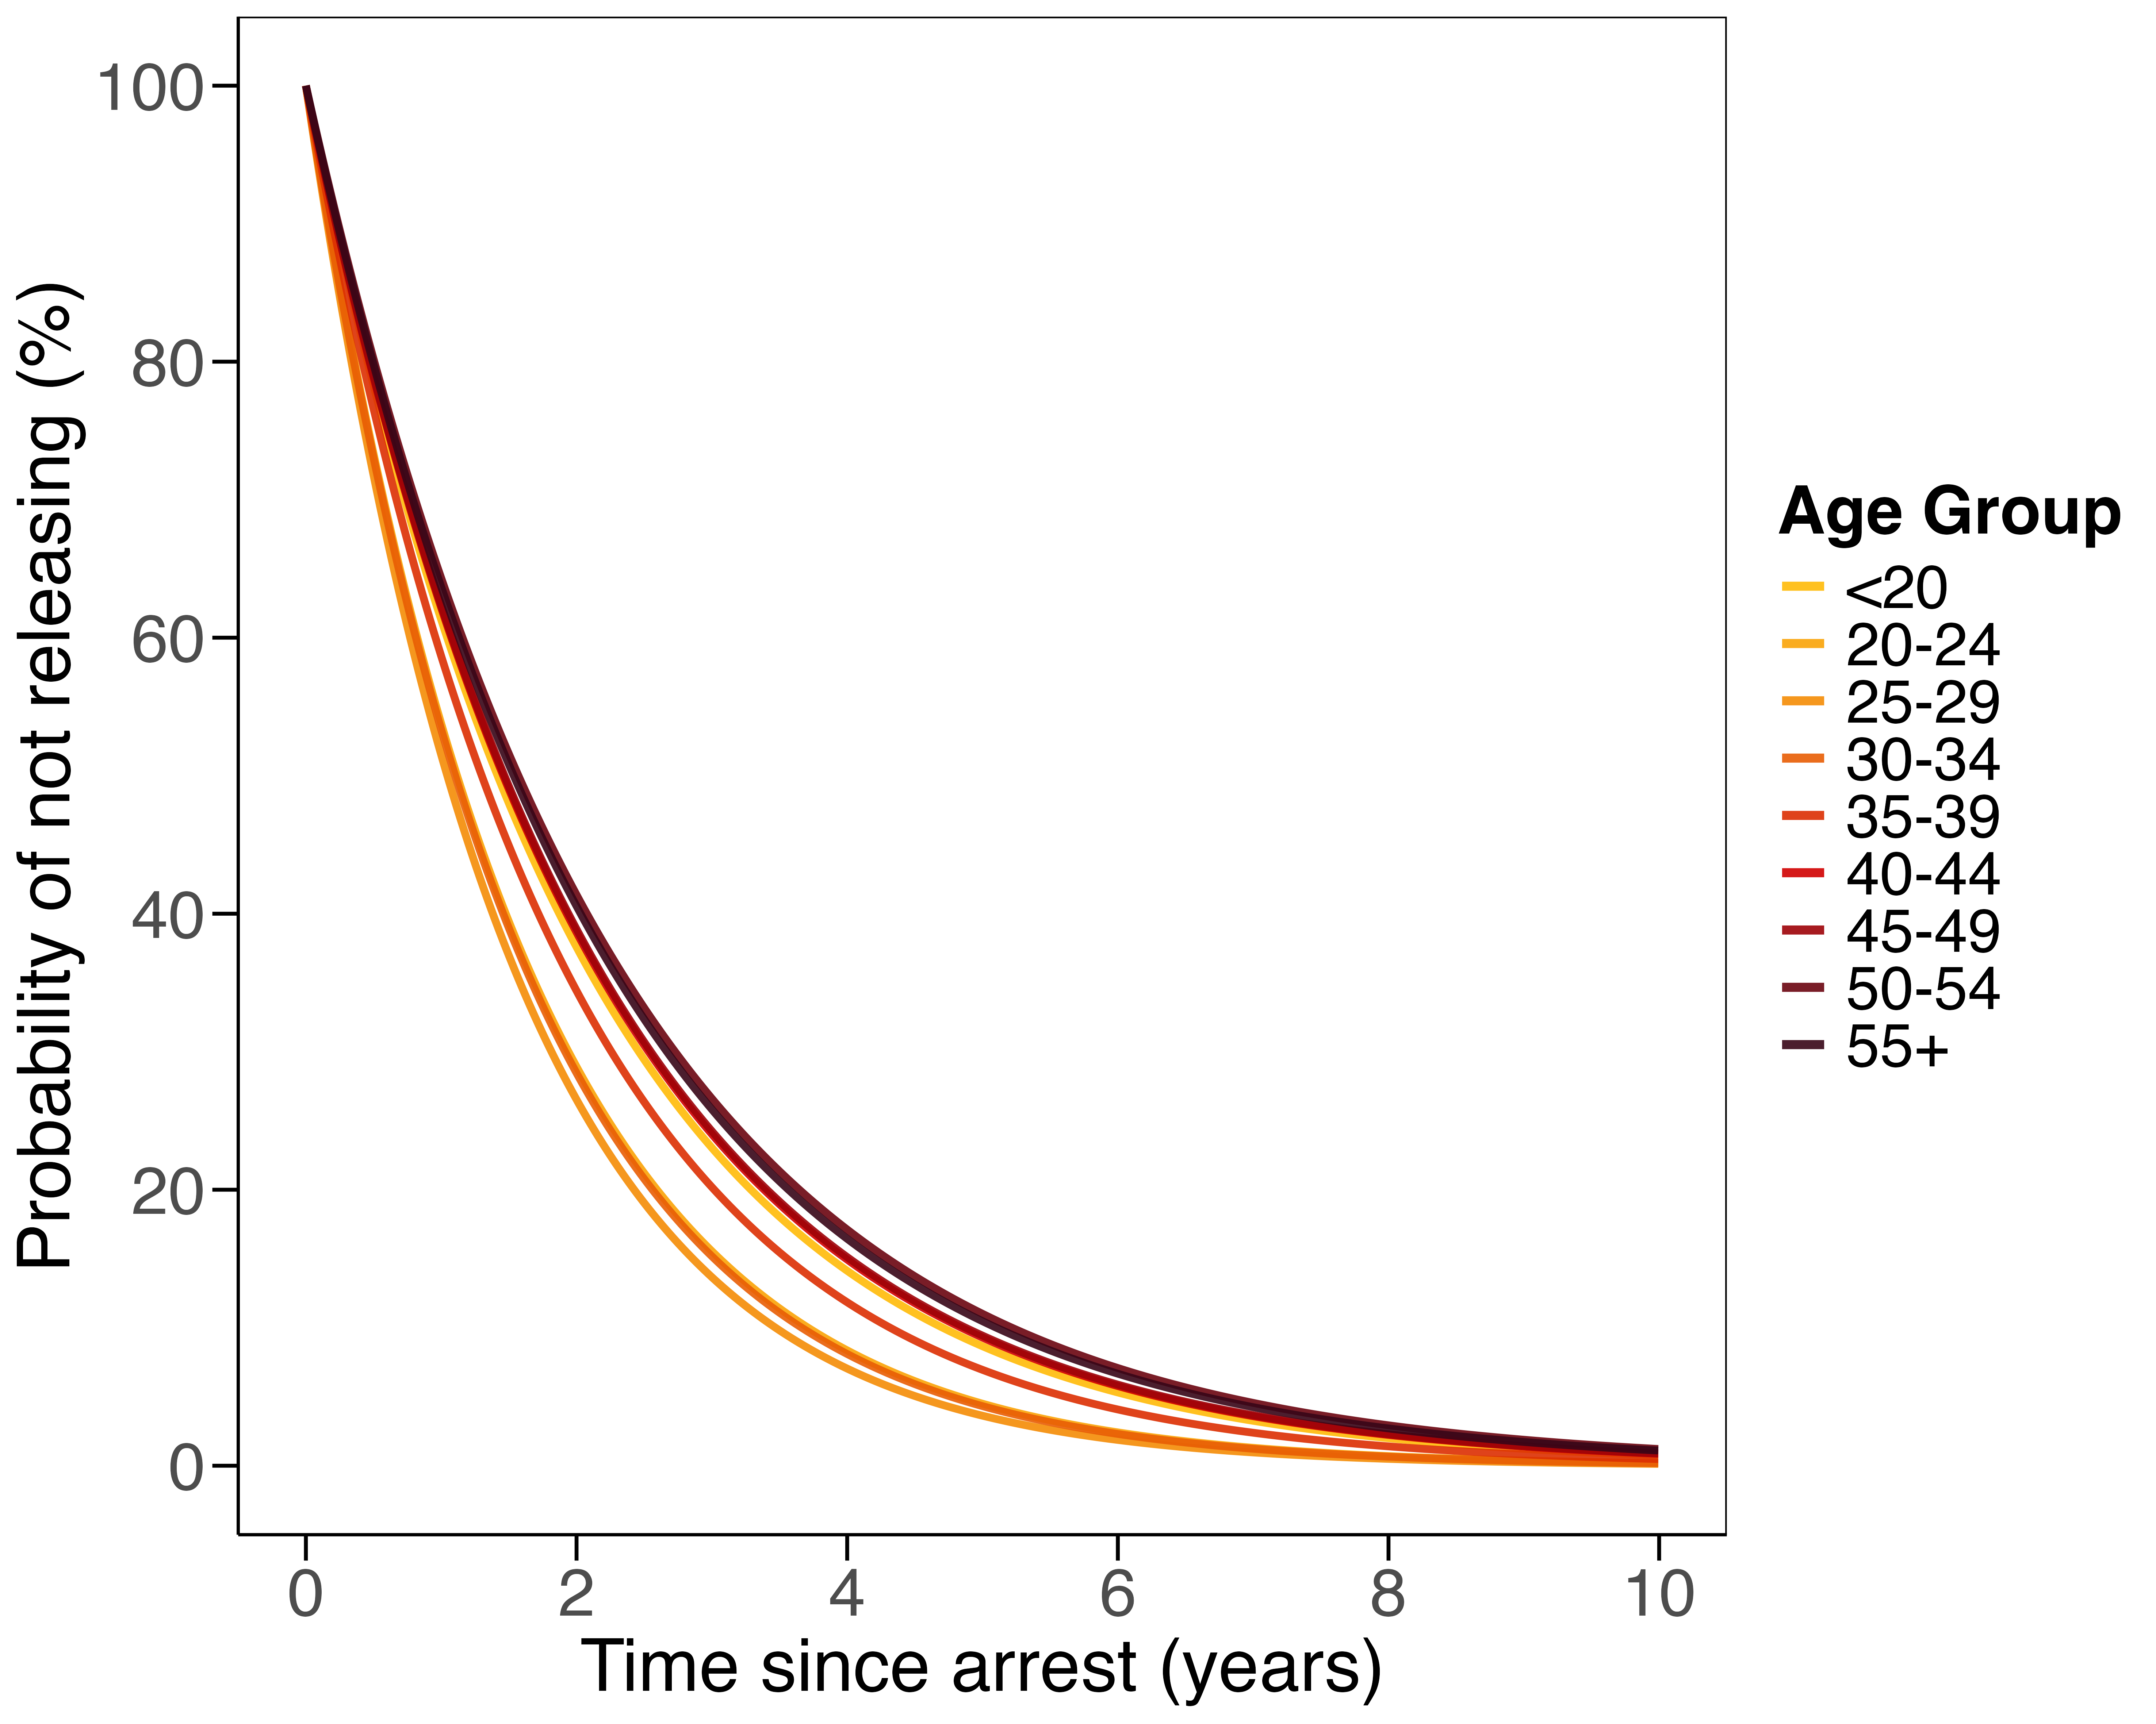

Slide 10
